Slide 1
IE 411/511:
Visual Programming for Industrial Applications
Lecture Notes #4
Control Statements – Part 1

Slide 2
Module Learning Objectives
In this module you will learn:
Basic problem-solving techniques
To develop algorithms through the process of top-down, stepwise refinement
To use the If…Then and If…Then Else selection statements to choose among alternative actions
To use the While, Do While…Loop and Do Until...Loop repetition statements to execute statements in a program repeatedly

Slide 3
Module Learning Objectives (cont.)
To use the compound assignment operators to abbreviate assignment operations
To use counter-controlled repetition
To use stacked and nested control statements
To use the debugger to help you locate logical errors

Slide 4
Algorithms
Computers solve problems by executing a series of actions in a specific order
An algorithm is a procedure for solving a problem, in terms of
  The actions to be executed, and
  The order in which these actions are executed
The most difficult part of a solving a problem on a computer is developing the algorithm for the solution
  Once a correct algorithm has been specified, the process of producing a working Visual Basic program from the algorithm is normally straightforward

Slide 5
Algorithms (cont.)
Consider the following three algorithms to perform the addition of two numbers:
  Column addition method
  Fast method
  Partial sums method
1 4 8
6 7
+ 2 6 6
1 4 8
6 7
+ 2 6 6

Slide 6
Algorithms (cont.)
Partial Sums Method
  First stage
    Look at each column (working left to right)
    Add up the place-values represented by the digits in that column
  Second stage
    Add partial sums together
  Variation
    Sometimes second stage and even the logical third stage involve carrying
148
67
+ 266
678
67
+ 266

Slide 7
Algorithms (cont.)
Pseudocode
Pseudocode is an abbreviated version of actual computer code
Pseudocode helps programmers develop algorithms
  It is similar to every­day English
  It is convenient and user-friendly
  Allows the programmer to focus on the steps required to solve the problem rather than on how to use the computer language
  Pseudocode programs are not executed on computers
Pseudocode normally describes only the actions that occur
  i.e., Input, output, calculations and decisions

Slide 8
Algorithms (cont.)
Pseudocode
Pseudocode does not include variable declarations such as Dim number As Integer
Pseudocode helps you conceptualize a program during the design process
The pseudocode program can be converted to Visual Basic (or any other language) at a later point

Slide 9
Algorithms (cont.)
Pseudocode Example
Write pseudocode to calculate the number of weeks and days from a total number of days

Slide 10
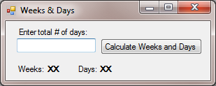
Algorithms (cont.)
In-Class Exercise
Write a program that calculates the number of weeks and days from a total number of days
frmWeekDays
lblTotalDays
cmdCalculate
txtTotalDays
lblWeeks
lblDaysResults
lblWeeksResults
lblDays

Slide 11
Control Structures
In the mid-1960s, mathematicians proved that any program, no matter how complicated, can be constructed using one or more of only three control structures¹:
  Sequence
  Selection
  Repetition
The term control structures comes from the field of computer science
Visual Basic’s implementation of control structures are referred to as control statements
¹Farrell, J. (2011). Programming Logic and Design Comprehensive (6th ed.). Boston, MA: Course Technology.

Slide 12
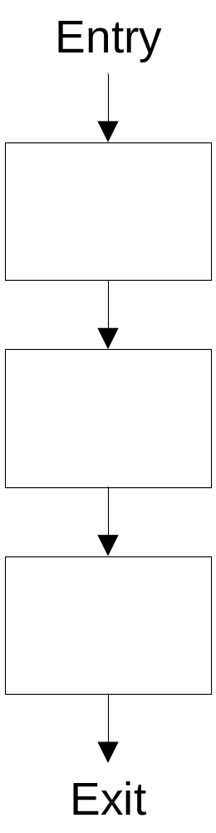
Control Structures (cont.)
Sequence Structure

Slide 13
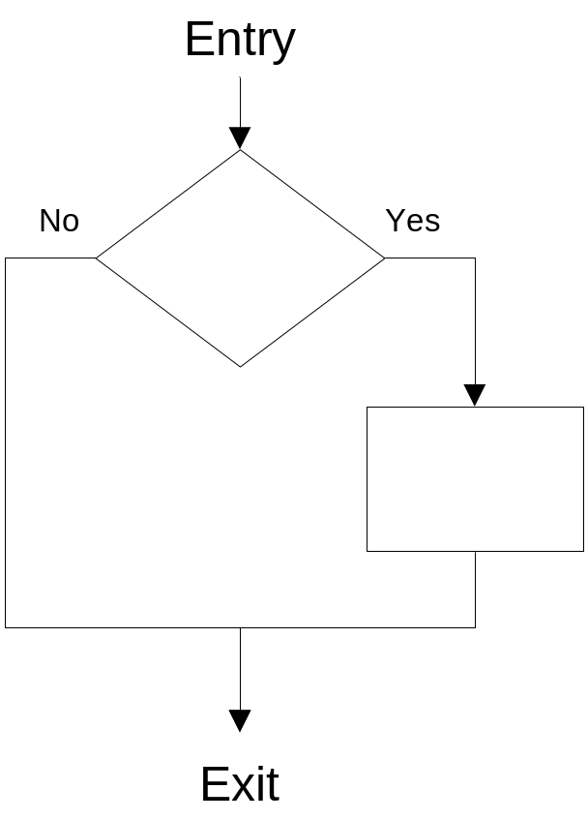
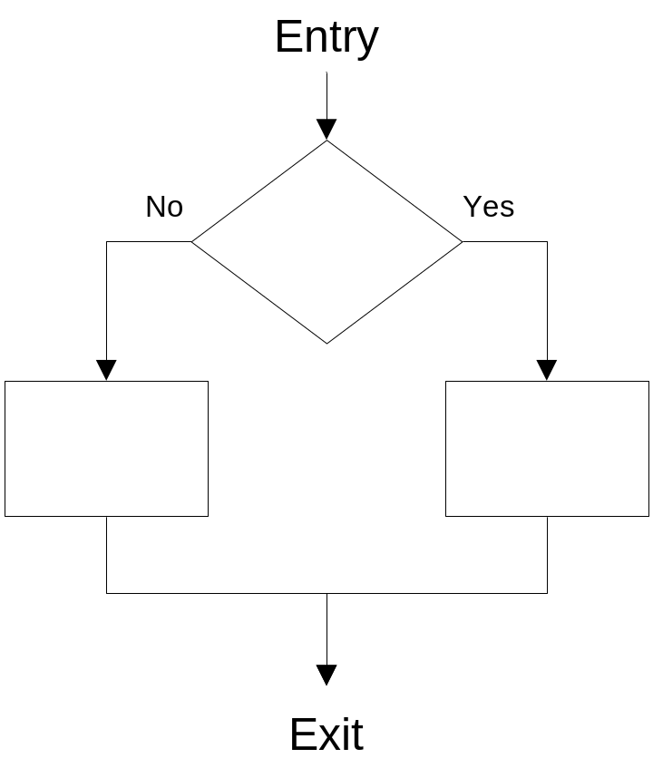
Control Structures (cont.)
Selection Structure
Single
Double

Slide 14
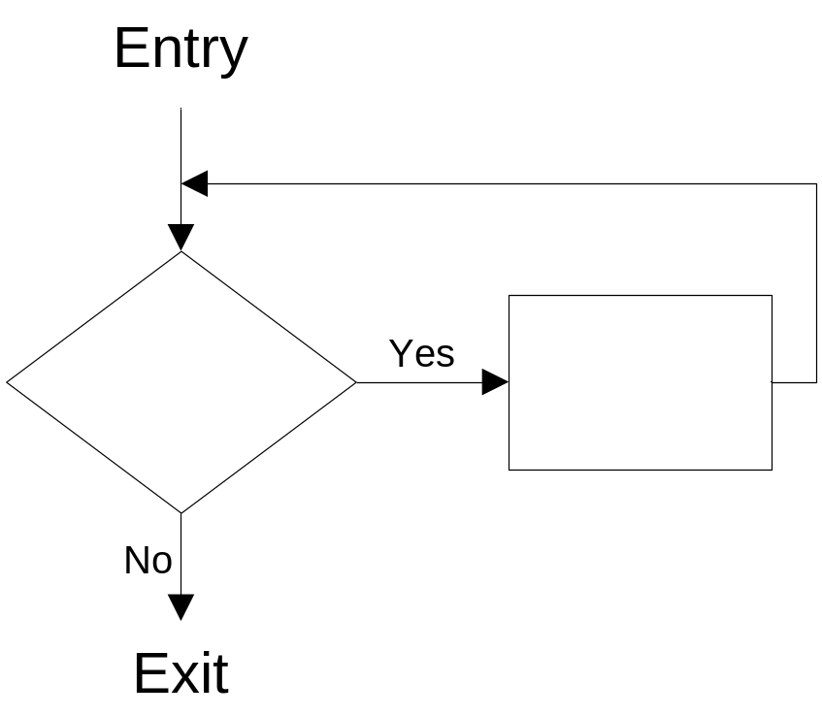
Control Structures (cont.)
Repetition Structure

Slide 15
Control Structures (cont.)
Any Visual Basic program can be constructed from eleven different types of control statements
  Sequence
  Three types of selection statements
  Seven types of repetition statements
These can be combined in only two ways
  Control-statement stacking
  Control-statement nesting

Slide 16
Control Structures (cont.)
Visual Basic Selection Statements
The If…Then single-selection statement
  Either performs an action or skips the action depending on a condition
The If…Then…Else double-selection statement
  Performs an action if a condition is true, and performs a different action if the condition is false
The Select…Case multiple-selection statement
  Performs one of many different actions, depending on the value of an expression

Slide 17
If…Then Selection Statement
Consider the following pseudocode
If student’s grade is greater than or equal to 60 then
Print “Passed ”
The preceding pseudocode If statement may be written in Visual Basic as
The statement also could be written as:
If studentGrade >= 60 Then
lblResult.Text = “Passed”
End If
If studentGrade >= 60 Then lblResult.Text = “Passed”

Slide 18
If…Then…Else Selection Statement
Consider the following pseudocode
If student’s grade is greater than or equal to 60 Then
Print “Passed”
Else
Print “Failed”
The preceding pseudocode If…Then…Else statement may be written in Visual Basic as
If studentGrade >= 60 Then
lblResult.Text = “Passed”
Else
lblResult.Text = “Failed”
End If

Slide 19
If…Then…Else Selection Statement (cont.)
Nested If ...Then...Else Statements
Nested If…Then…Else statements test for multiple conditions:
If student’s grade is greater than or equal to 90 then
Print “A”
Else
If student’s grade is greater than or equal to 80 then
Print “B”
Else
If student’s grade is greater than or equal to 70 then
Print “C”
Else
If student’s grade is greater than or equal to 60 then
Print “D”
Else
Print “F”

Slide 20
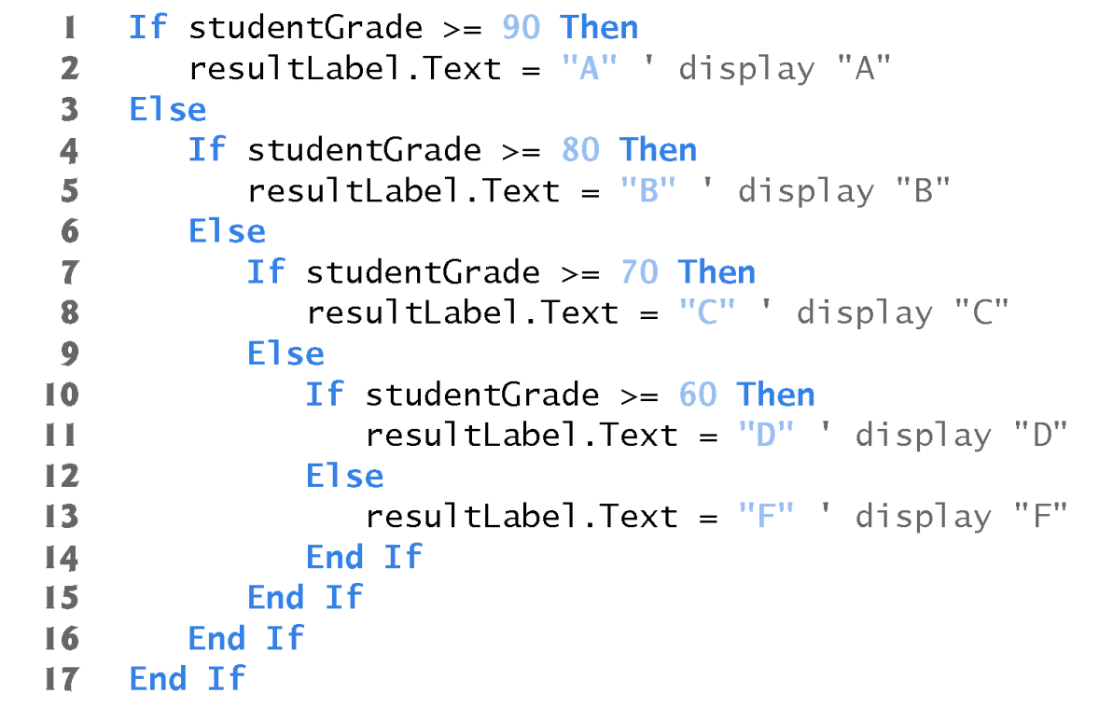
If…Then…Else Selection Statement (cont.)
The preceding pseudocode may be written in Visual Basic as follows

Slide 21
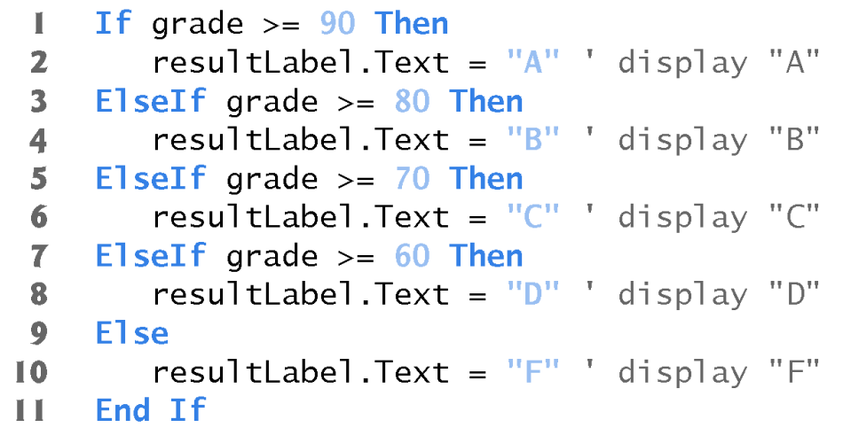
If…Then…Else Selection Statement (cont.)
Most Visual Basic programmers prefer to use the ElseIf keyword

Slide 22
Repetition Statements
A repetition statement repeats an action, depending on the loop-continuation condition
When the condition becomes false, the first statement after the repetition statement executes
While there are more items on my shopping list
Put next item in cart
Cross it off my list

Slide 23
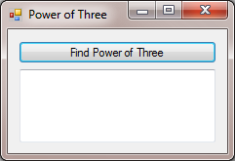
Repetition Statements (cont.)
In-Class Exercise
Write a program that finds the first power of 3 larger than 100 using a While repetition statement
frmPowerOfThree
cmdFindPower
txtResult

Slide 24
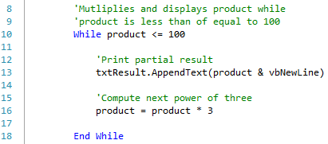

Do While Loop Repetition Statement
The Do While…Loop repetition statement behaves exactly like the While repetition statement
  With While…End While
  With Do While…Loop

Slide 25

Do Until Loop Repetition Statement
A Do Until…Loop is executed repeatedly as long as the loop-termination condition is false

Slide 26
Infinite Loops
Failure to provide the body of a While statement or a Do While statement with an action that eventually causes the loop continuation condition to become false is a logic error
Failure to provide the body of a Do Until…Loop statement with an action that eventually causes the loop-termination condition to become true is a logic error
Such repetition statements never terminate, resulting in a logic error called an infinite loop

Slide 27
Compound Assignment Operators
Assume you have a variable named count
count will be incremented by 7 and the result assigned to it again
You can write this assignment as follows:

Slide 28
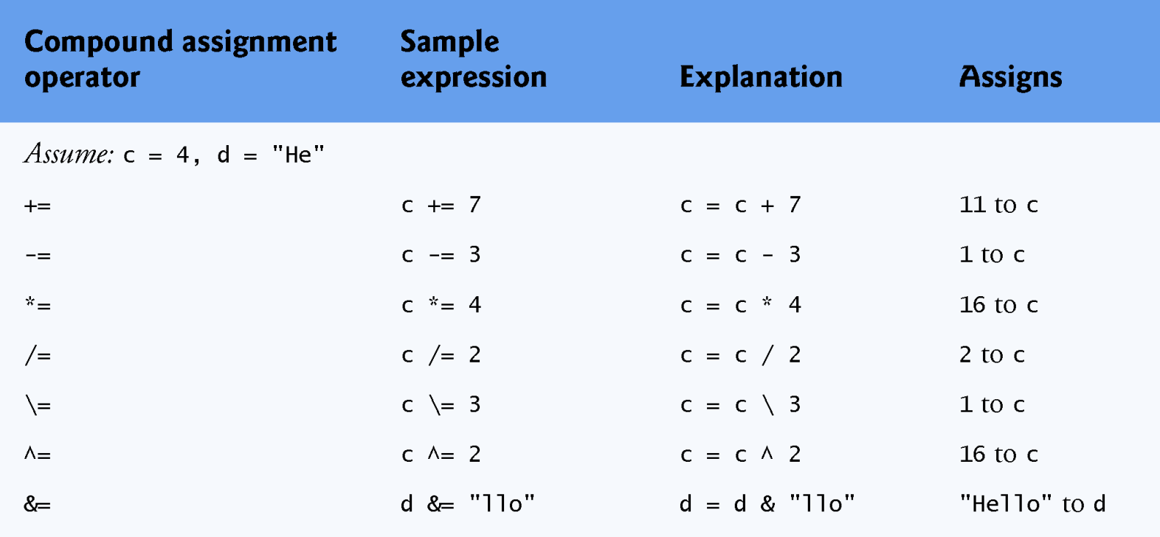
Compound Assignment Operators (cont.)
The variable on the left side of an assignment operator must be a “left value”
  An “left value” (lvalue ) is a modifiable variable or property that can appear on the left side of an assignment statement
  Constants cannot be lvalues

Slide 29
Compound Assignment Operators (cont.)
When an assignment (=) is evaluated, the expression to the right of the operator is always evaluated first, then the value is assigned to the lvalue on the left
The =, +=, -=, *=, /=, \=, ^= and &= operators are always applied last in an expression
  When a compound assignment is evaluated, the appropriate operator is applied to the lvalue’s original value and the value to the operator’s right, then the resulting value is assigned to the lvalue on the left

Slide 30
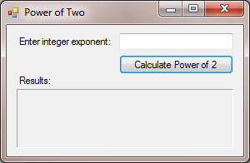
Compound Assignment Operators (cont.)
In-Class Exercise
Write a program to calculate a power of two using the exponentiation assignment operator
frmWeekDays
lblPrompt
txtExponent
lblTitleResults
cmdCalculate
lblResult

Slide 31
Formulating Algorithms
Counter-Controlled Repetition
Consider the following problem statement:
A class of students took a quiz. The grades for this quiz (integers in the range 0 to 100) are available to you. Determine the class average on the quiz.
What must the algorithm for solving this problem do?

Slide 32
Formulating Algorithms (cont.)
The Pseudocode Algorithm with counter-controlled repetition for this problem is as follows:
1
2
3
4
5
6
7
8
9
10
11
12
13
Initialize total to zero
Initialize grade counter to zero
While grade counter is less than the number of grades
Get the next grade
Add the grade into the total
Add one to the grade counter
If the grade counter is not equal to zero then
Set the class average to the total divided by the number of grades
Display the class average
Else
Display “No grades were entered”

Slide 33
Formulating Algorithms (cont.)
The essentials of counter-controlled repetition include:
  The name of the control variable
  The initial value
  The increment (or decrement) value
  The condition that tests for the final value

Slide 34
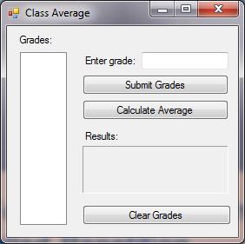
Formulating Algorithms (cont.)
In-Class Exercise
Write a program to calculate the average of a quiz taken by a group of students
GUI for the Class-Average App
frmClassAverage
lblGrades
txtGrade
lblGrade
cmdEnterGrade
cmdCalculateAvg
lstBoxGrades
lblClassAvg
lblClassAvgResults
cmdClearGrades

Slide 35
Formulating Algorithms (cont.)
Notes about this program
The ListBox control is used to display the grades the user enters and to manipulate those grades to perform the class-average calculation
Each grade that the user enters into the program by pressing the “Submit Grade” Button is placed in the ListBox
The class average is calculated when the user presses the “Calculate Average” Button
A “Clear Grades” Button is also provided to remove all the grades from the ListBox and clear the results, so the user can enter a new set of grades

Slide 36
Formulating Algorithms (cont.)
Notes about this program
Although Visual Basic initializes numeric variables
to 0, it is a good practice to initialize certain variables explicitly to avoid confusion and improve program readability
Assuming that integer division rounds (rather than truncates) can lead to incorrect results
  For example, 7 divided by 4, which yields 1.75 in conventional arithmetic, truncates to 1 in integer arithmetic rather than rounding to 2

Slide 37
Formulating Algorithms (cont.)
Floating-Point Number Precision and Memory Requirements
Variables of type Single represent single-precision floating-point numbers and have seven significant digits
Variables of type Double represent double-precision floating-point numbers
  Floating-Point numbers are approximations
  Type Double is preferred over type Single because Double variables can represent floating-point numbers more accurately
  Using floating-point numbers in a manner that assumes they are represented precisely can lead to logic errors

Slide 38
Formulating Algorithms (cont.)
Implicitly Converting Between Primitive Types
The floating-point division operator operates on Single, Double and Decimal values
  To ensure that the operands are one of these types, Visual Basic performs implicit conversion
  If both operands are of type Integer, the operands will be promoted to Double values

Slide 39
Formulating Algorithms (cont.)
“{0:F}” indicates that the value should be displayed as a fixed-point number
This is an example of formatted output of a value’s data
The numeric value that appears before the colon indicates which argument will be formatted
The value after the colon is known as a format specifier
  When formatting with two positions to the right of the decimal point, some programmers prefer to use the format specifier F2 for clarity

Slide 40
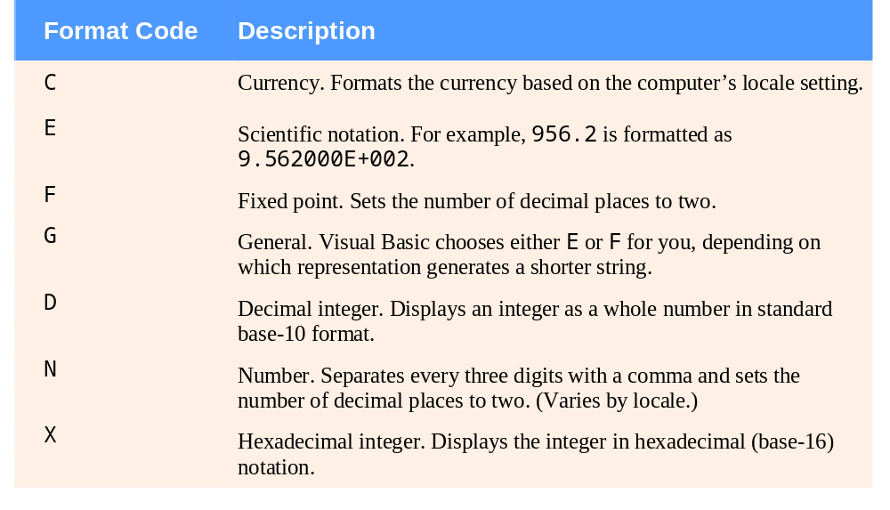
Formulating Algorithms (cont.)
Some common format specifiers

Slide 41
Formulating Algorithms (cont.)
The last program showed that control statements can be stacked on top of one another (in sequence)
In the next discussion, we examine the only other structured way that control statements can be combined
  i.e., Nesting one control statement inside another

Slide 42
Formulating Algorithms (cont.)
Nested Control Statements
Consider the following problem statement
A college offers a course that prepares students for the state real estate broker licensing exam. Last year, 10 of the students who completed this course took the exam. The college wants to know how well its students did. You’ve been asked to write a program to summarize the results. You’ve been given a list of the 10 students. Next to each name is written a “P” if the student passed the exam and an “F” if the student failed the exam.

Slide 43
Formulating Algorithms (cont.)
Nested Control Statements
Design a solution that does the following
  Inputs each exam result (that is, a “P” or an “F”).
  Counts the number of passes and the number of failures.
  Displays a summary of the exam results, indicating the number of students who passed and the number who failed.
  If more than eight students passed the exam, displays the message “Bonus to Instructor.”

Slide 44
Formulating Algorithms (cont.)
Nested Control Statements
Proceed with top-down, stepwise refinement
Our first refinement is
Analyze exam results and decide if the instructor should receive a bonus

Slide 45
Formulating Algorithms (cont.)
Nested Control Statements
Second refinement
  Only the counters for the number of passes, number of failures and number of students need to be initialized

Slide 46
Formulating Algorithms (cont.)
Nested Control Statements
Input the ten exam results, and count passes and failures
A loop successively inputs the result of each exam

Slide 47
Formulating Algorithms (cont.)
Nested Control Statements
Display a summary of the exam results and decide if the instructor should receive a bonus
The preceding pseudocode statement may be refined as follows

Slide 48
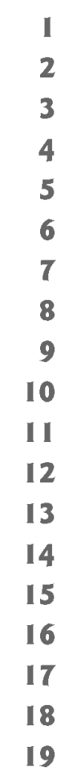
Formulating Algorithms (cont.)
The complete second refinement of the pseudocode is as follows

Slide 49
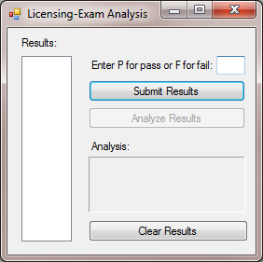
Formulating Algorithms (cont.)
In-Class Exercise
GUI for the Pass-Fail App
frmClassPassFail
lblResults
txtGrade
lblGrade
cmdSubmitResults
cmdAnalyzeResults
lstBoxResults
lblAnalysis
lblAnalysisResults
cmdClearResults

Slide 50
Using the Debugger
Logic errors result from unexpected occurrences in the application or problems in the code (e.g., calling the wrong method)
  A fatal logic error causes a program to fail and terminate prematurely
  A non-fatal logic error causes the program to produce incorrect results

Slide 51
Using the Debugger (cont.)
Locating a Logic Error
Visual Studio includes a tool called a debugger that can be used to monitor the execution of your programs so you can locate and remove logic errors (also called bugs)
Logic errors do not prevent a program from compiling successfully, but can cause a running program to produce incorrect results
A program must successfully compile before it can be used in the debugger

Slide 52
Using the Debugger (cont.)
Some of the debugger’s features include:
  Suspending program execution so you can step through the program one statement at a time
  Examining and setting variable values
  Watching the values of variables and expressions
  Viewing the order in which methods are called

Slide 53
Using the Debugger (cont.)
Open the Class Average App developed in class
Locate the sub procedure cmdCalculateAvg_Click
Locate the Do While loop inside cmdCalculateAvg_Click
Change the “<“ operator with the “<=“ operator
Execute the program with Debug>Start Debugging
  You can also press F5
Enter a few grades and press the “Calculate Average” button
  The program does not display the class average
  Rather, you get a dialog showing a runtime error known as an InvalidArgument

Slide 54
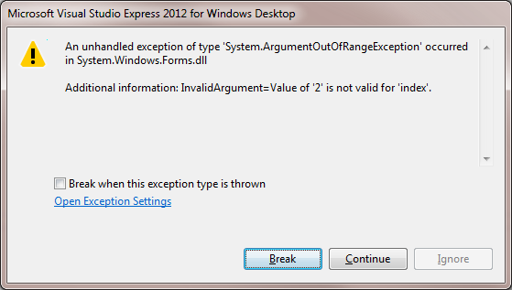
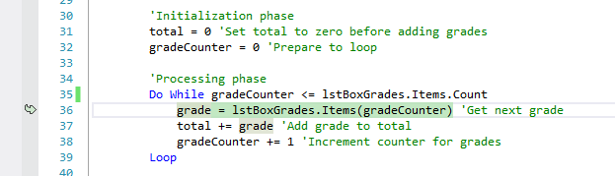
Using the Debugger (cont.)
This logic error (commonly known as an off-by-one error) is frequently caused by using the incorrect relational operator in a loop’s condition
The debugger also highlights the line of code that caused the problem

Slide 55
Using the Debugger (cont.)
Breakpoints
Breakpoints are markers that you can set at any executable line of code
  When a running program reaches a breakpoint, execution pauses
  Allows you to examine the values of variables and expressions to help determine whether logic errors exist
Once the debugger pauses program execution, you can use various debugger commands to execute the program one statement at a time
  This is called single stepping or simply stepping

Slide 56
Using the Debugger (cont.)
Breakpoints
To insert a breakpoint
  Left click in the margin indicator bar (the gray margin at the left of the code window
  Right click on a line and select Breakpoint > Insert Breakpoint
  Click a line of code, then press F9 to toggle a breakpoint on and off
You may set as many breakpoints as you like
A solid circle appears in the margin indicator bar where you clicked and the entire code statement is highlighted, indicating that a breakpoint has been set

Slide 57
Using the Debugger (cont.)
Breakpoints
After setting breakpoints in the code editor, select Debug > Start Debugging to rebuild the program and begin the debugging process
  Enter the grades 100, 97 and 88, then press the Calculate Average button
When the debugger reaches a breakpoint, it suspends execution and enters break mode
  At this point, the IDE becomes the active window
  The yellow arrow to the left of line with the breakpoint (called the instruction pointer) indicates that this line contains the next statement to execute
  The IDE also highlights the line as well to emphasize the line that is about to execute

Slide 58
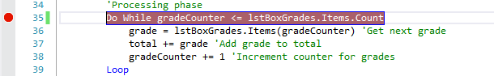
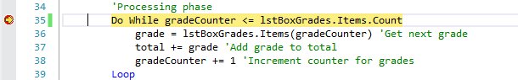
Using the Debugger (cont.)
Breakpoints
Breakpoint
Instruction pointer

Slide 59
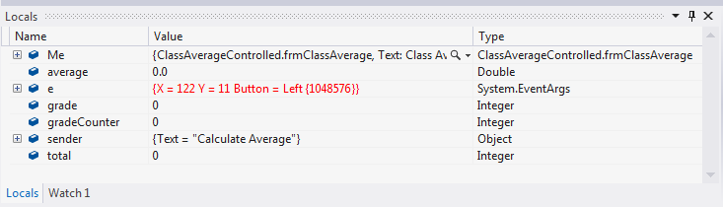
Using the Debugger (cont.)
Breakpoints
In break mode, you can place the mouse cursor over any variable and its value will be displayed in a Data Tip box
  This can help you spot logic errors
You can also explore the values of a method’s local variables using the debugger’s Locals window

Slide 60
Using the Debugger (cont.)
Step Over Command
In break mode, you can execute the program one statement at a time using the debugger’s Step Over command
  Debug > Step Over
  Press F10

Slide 61
Using the Debugger (cont.)
To execute the program without the breakpoints, you can:
  Disable each breakpoint by right clicking in the line of code with the breakpoint and selecting Breakpoint > Disable Breakpoint, then run the program
  Remove each breakpoint by right clicking the breakpoint and selecting Delete Breakpoint, then run the program; or
  Execute the program without debugging by pressing Ctrl + F5

